Slide 1

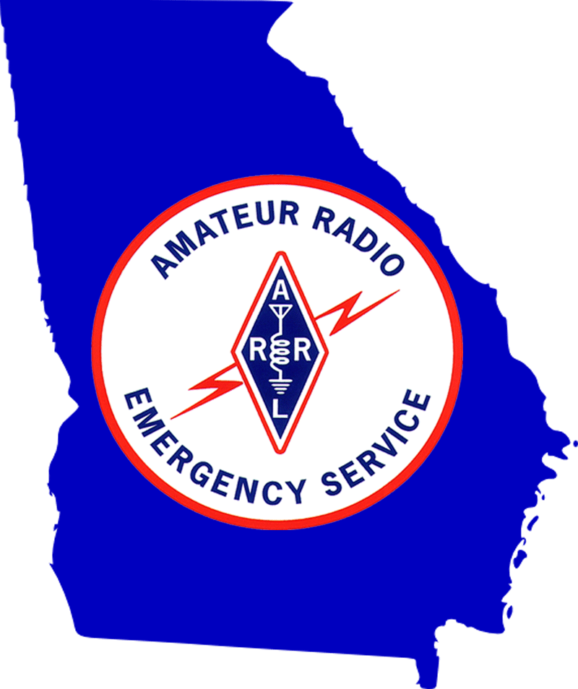



Georgia ARES Hospital Network
When power, Internet, and cellphone communications are lost …
We have solutions!
County EMA
GA EMA

Slide 2

Georgia ARES Hospital Team
Who are We and How Do You Engage Us?
Emergency Communications Requirement
Georgia ARES Hospital Team Requirements
Your Facility is Part of a Bigger Picture
At the Facility – Radio Station, Staffing, Training & Reporting
Key Elements to Success

Slide 3
Georgia ARES Hospital Team
The Amateur Radio Emergency Service (ARES ®) is a program of the American Radio Relay League (ARRL)
In the event of a disaster we use radios, computers, and special software leveraging various frequencies, data modes, and techniques to provide vital communications when conventional communications are disrupted
Our services are provided by volunteer, licensed amateur radio operators with specialized training using frequencies allocated to us by the FCC
The Hospital Team is a public health functional interest area of ARES
Notes:
URLs:
ARRL ARES: http://www.arrl.org/ares
Georgia ARES Hospital Team: https://gaares.org/heop.php

Slide 4
Georgia ARES Hospital Team Structure
Section (Georgia)
Emergency Coordinator (SEC)
District (Regional)
Emergency Coordinator (DEC)
District
ADEC Public Health
County
Emergency Coordinator (EC)
Section
ASEC Public Health
County
AEC Public Health
Leadership Chain
Assistants for Functional Area
Notes:
Note that:
The leadership Emergency Coodinator chain has a broad responsibility that goes well beyond the hospital operations interest area
The leadership chain has access to resources beyond the hospital team
The leadership chain has assistants to focus on functional areas of interest

Slide 5
Engaging the Georgia ARES Hospital Team
To initiate establishment of an ARES Hospital Team function at your health facility contact the Georgia State ARES Section leadership:
https://gaares.org/contact.php
In your contact request please identify your interest in establishing a ARES Hospital Team presence at your facility, provide your health facility name and county of location
The state Section leadership team will connect you with the local county Emergency Coordinator (EC) or other appropriate resource

Slide 6
CMS Emergency Communications Requirement
Title 42 CFR 482.15 (c) (3) Establish primary and alternate communication
Effective 11/15/16 with implementation by 11/15/17
Primary and alternate means for communicating with the following:
(i) [Facility] staff
(ii) Federal, State, tribal, regional, and local emergency management agencies
CMS State Operations Manual Appendix Z (Interpretive guidelines)
Require facilities to have installed and immediately available a method of communication that is independent of the Internet, cellphone towers, and the power distribution network
Lists Amateur Radio Operators’ (HAM Radio) systems as a solution
Notes:
Hospital Team members focus on external communications:
emergency management agencies
local and regional partners

Slide 7
FEMA Course AWR-336 Health Sector Emergency Preparedness
Facilities are to have an alternate means to communicate with their staff and Federal, state and local emergency management agencies during an emergency ...
The following are examples of alternative devices:
Pagers
Internet provided by satellite or non-telephone cable systems
Cellular telephones (where appropriate). Facilities can also carry accounts with multiple cell phone carriers to mitigate communication failures during an emergency
Radio transceivers (walkie-talkies)
Various other radio devices such as the NOAA Weather Radio and Amateur Radio Operators’ (HAM) systems
Satellite telephone communication system

Slide 8
Why Use Amateur Radio Emergency Service?
Amateur radio communications is specifically noted by FEMA and CMS as satisfying emergency communication requirements
The Georgia Hospital Association (GHA) named the Georgia ARES Section as a solution provider
Within GA ARES the Hospital Team is designed to met the CMS requirement providing effective communication connectivity to local and state emergency management
Satellite solutions are expensive, difficult to maintain, require a clear view of the sky (e.g. do not work indoors), and do not work during severe weather
Notes:
ARES Operators develop skills in and routinely practice emergency communications
Knowledge of commonly accepted amateur radio practices
Skill in acting as a net control operator
Familiarity with passing traffic, both by voice and by digital means.
Georgia ARES has a team specializing in health care facility external emergency communications
Program defined in GA ARES HOSPITAL EMERGENCY OPERATIONS PLAN for Hospital Emergency Radio Operators

Slide 9
GA ARES Hospital Team Requirements
Operators receive background checks and credentialed with GA State ARES
Operators receive HIPAA initial and biennial refresher training
Operators are trained in amateur radio communication voice and digital techniques necessary for connectivity with county EMA, State GEMA, Regional Coordinating Hospitals, and Region-wide hospital networks
Operators are registered with and trained in the use of GHA911 WebEOC
Operators are registered with the Everbridge notification system
Operators are trained to present themselves in a professional manner within the facility environment
Notes:
Two operator levels (I & II)
Additional training specific to facility emergency communications
Georgia Hospital Emergency Communications
HIPAA Training for Georgia ARES Hospital Net (initial and biennial)
WinLink for Hospital Communications
GHA911 WebEOC Training for facility Operators
Routinely practice analog voice and digital communications

Slide 10
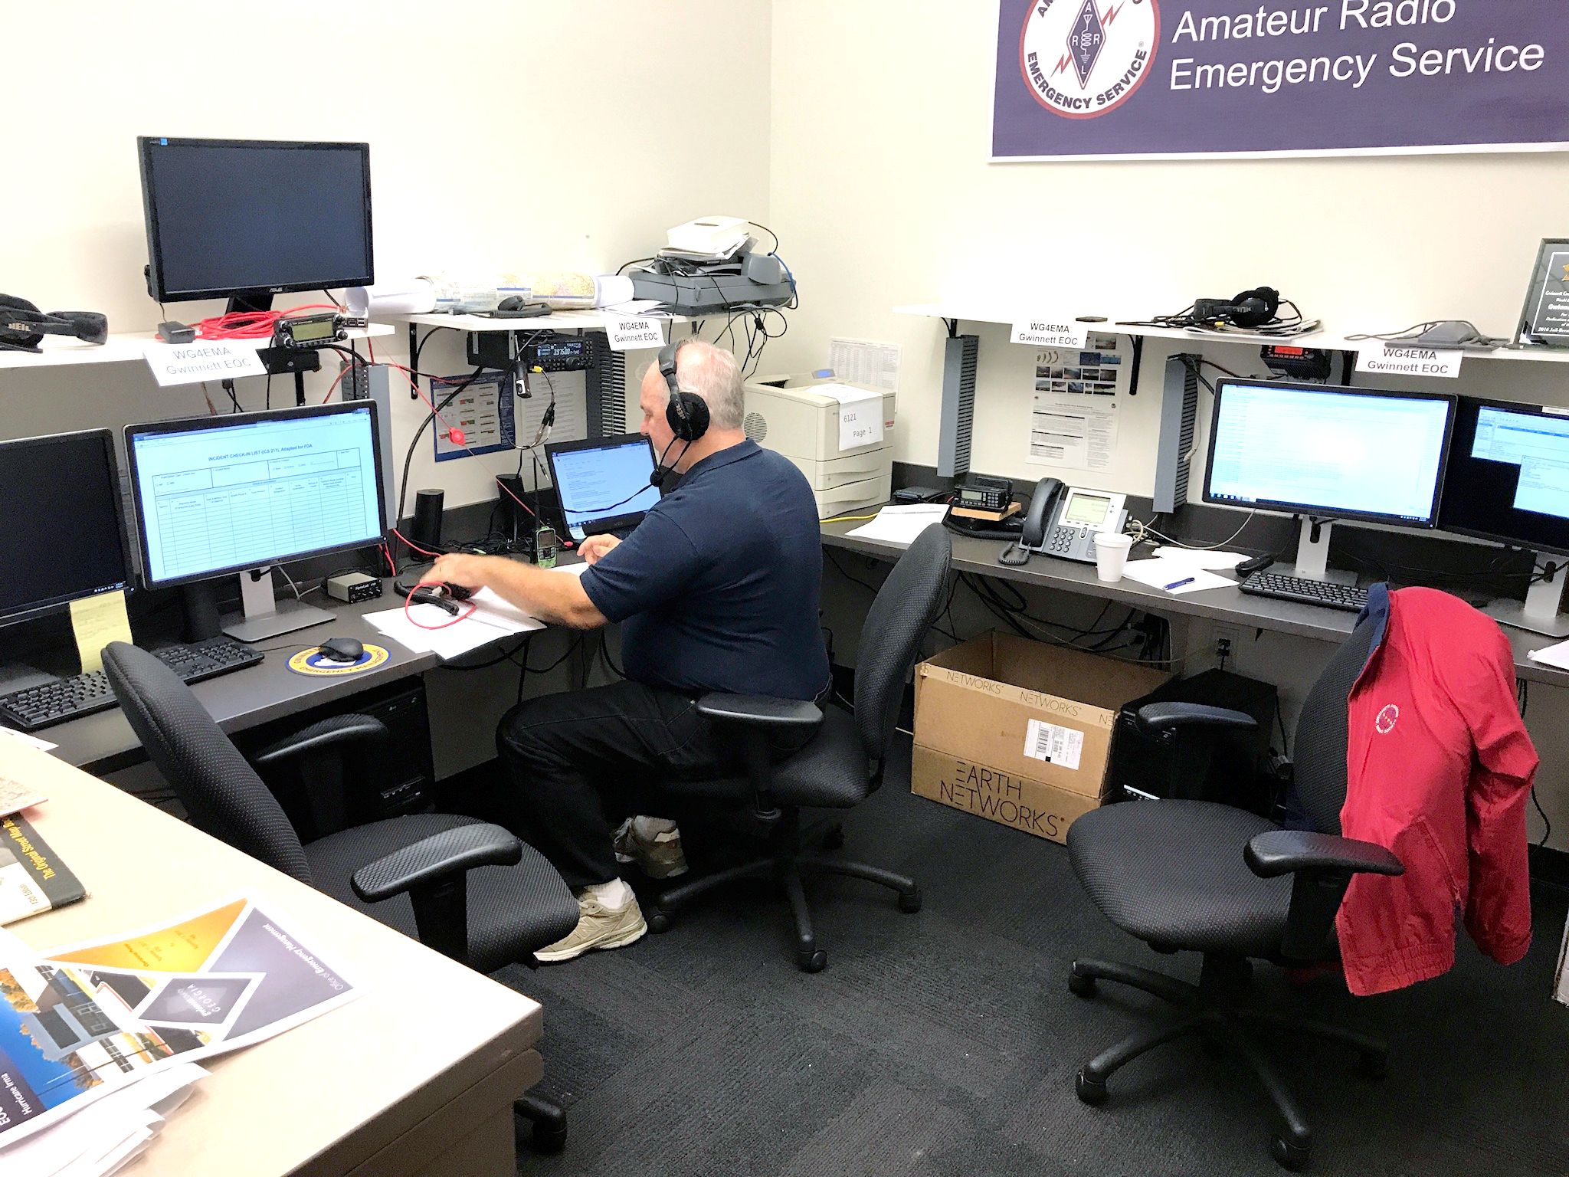
Requirements (cont’d)
Gwinnett Co EOC ARES Radio Station
Operators are under ICS protocol, taking their orders from the facility Incident Commander
Operators are trained to work with county and state EMAs
Many county EMAs have signed MOUs with ARES and provide radio rooms at their EOCs
During statewide emergencies we have ARES operators at GEMA (Atlanta and/or backup site)

Slide 11
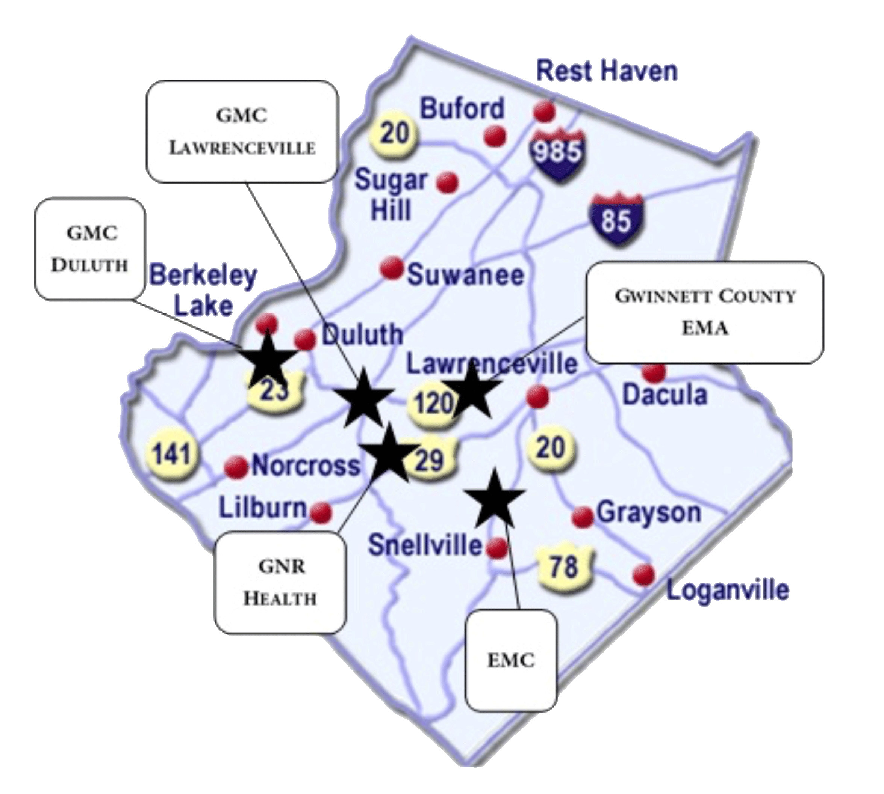
Your Facility is Part of a Bigger Picture
County Emergency Operations Center (EMA)
Eastside Medical Center (EMC)
Gwinnett Medical Center Lawrenceville
Gwinnett Medical Center Duluth
Gwinnett-Newton-Rockdale Health Department
Gwinnett Co Example

Slide 12
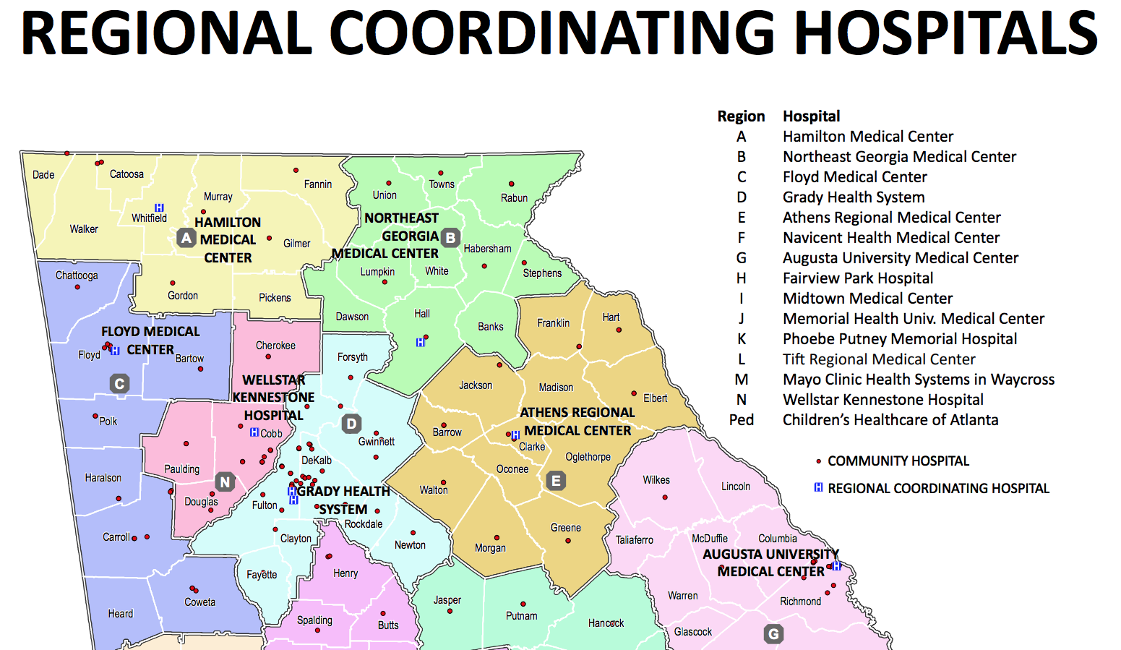
Each County is a Part of a Bigger Regional Picture

Slide 13
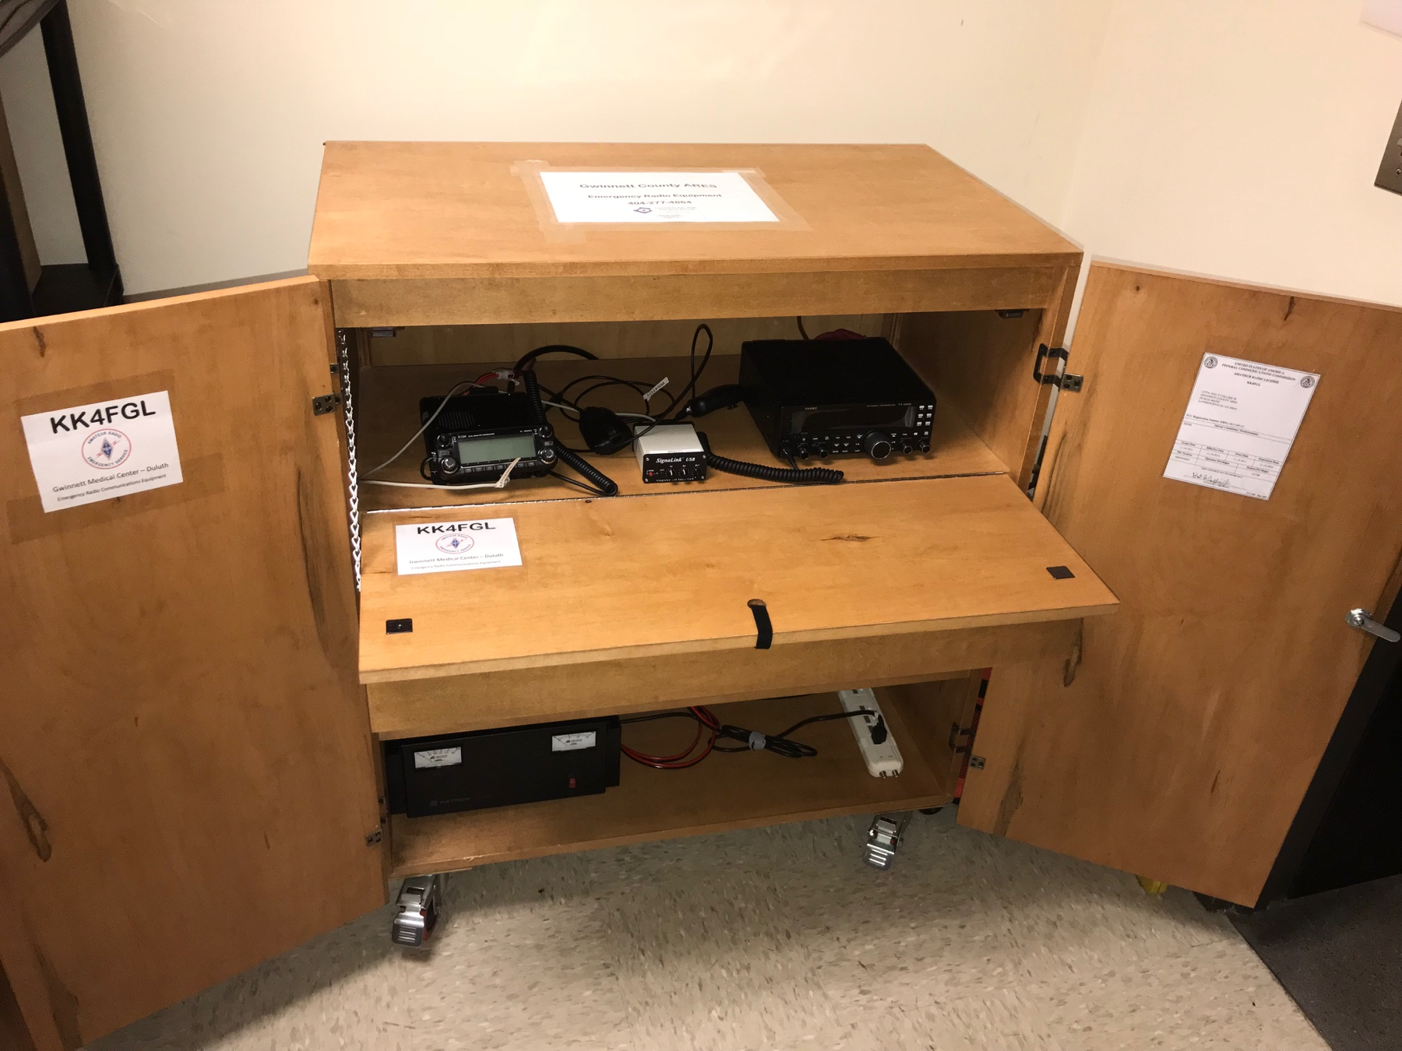
At the facility – Radio Station
VHF / UHF
D-Star
Radio
HF
Radio
With facilities properly outfitted, ARES operators can communicate with the EOC and key partners in the region
Basic operating station requirements:
VHF/UHF, D-Star & HF radios
Strategically placed antennas
Emergency power (e.g. RED plug)
Physical security for equipment
Internal communication to facility emergency management
ARES team credentialed with facility
ARES team integration into facility ICS program
Digital Data Interface
Gwinnett Medical Center @ Duluth Radio Station

Slide 14
At the Facility - Staffing & Training
Our goal is to staff each served facility with qualified, credentialed volunteers that will allow for extended 24 hour coverage broken into 12 hour shifts
We conduct and document monthly statewide ARES Hospital Network drills practicing all our communications techniques
We are active in county and statewide ARES learning and drill activities
Include the ARES team in facility emergency drills so we will be familiar with facility emergency management operations and associated EM staff
Notes:
Georgia ARES Hospital Emergency Operations Plan
Includes level I and II operator qualification requirements
Inclusion in facility emergency drills
ARES monthly drills are typically between facility radio communication stations and state level ARES net control stations, they do not involve the facility ICS team
Inclusion with facility ICS team builds people relationships
Inclusion in facility drills identifies “last-mile” (radio station to ICS EOC) communications issues requiring attention to correct

Slide 15
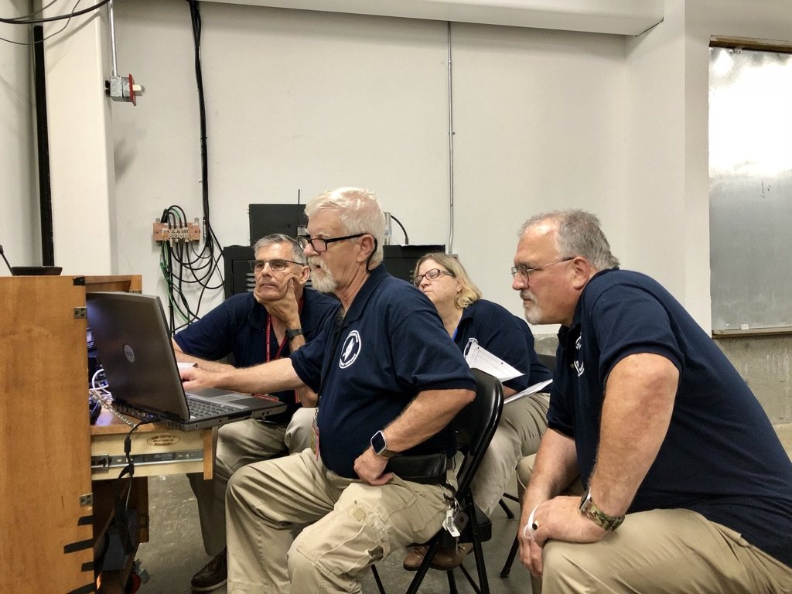
At the Facility - Monthly Exercise
Monthly exercise provide
Hands-on training for operators
Verification of equipment operational state
Identification of areas for improvement
A standard training format
Employs radio technologies to be used during an actual emergency
Drill, drill, drill …
Exercise is documented
Formal record of facility participation (useful for Joint Commission & CMS audit / survey)
Tracks individual operator participation

Slide 16
Standard Monthly Training Format
GHA WebEOC check-in; monitored for duration of drill
Check-in to Regional RCH (or alternate RCH) using direct voice radio communication
ICS-213 message sent via digital radio communication
List facility (using call sign in addition to name) and status
Control operator listed along with additional on-site operators
Digital voice statewide check-in on D-Star and VHF/UHF radio network
HF voice statewide check-in
Station communication is logged on ICS-309 form and maintained with station records
Notes:
The GA State ARES Hospital Net NCS sends specific directions for each monthly training net to all participating operators.
ICS-213 includes the Hospital/Facility, Operator Name(s), Call(s), and if you are “on-site” using the hospitals equipment or are “remote”
Logs are useful for Joint Commission /CMS audit / survey

Slide 17
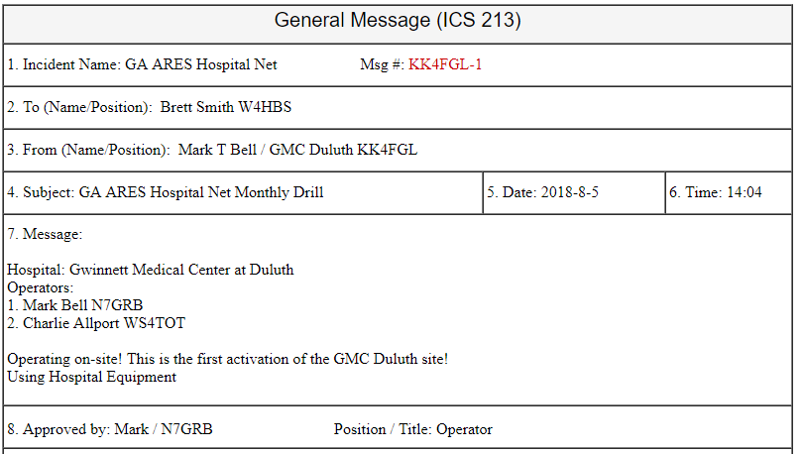
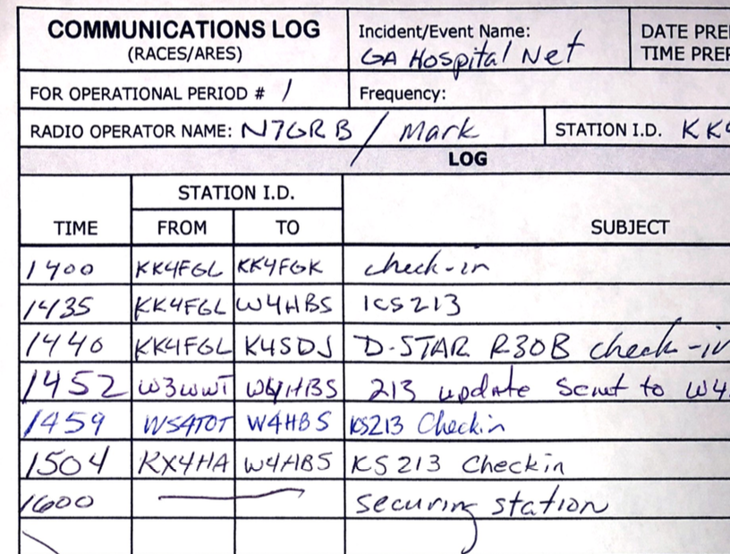
Standard ICS Forms
Communications Log ICS-309
1st GMC-D Activation ICS-213
Typical ICS forms used at the radio station:
ICS-211 Check-in, ICS-213 Message, ICS-214 Activity, ICS-309 Comm Log
Notes:
From FEMA statement:
The use of these standardized ICS Forms is encouraged to
promote consistency in the management and documentation of incidents in the spirit of NIMS, and
to facilitate effective use of mutual aid.
ARES Hospital Team members are trained in and expected to use ICS communication forms in their function / role
Blank, ready to use copies of the typically used forms should be maintained at the radio station

Slide 18
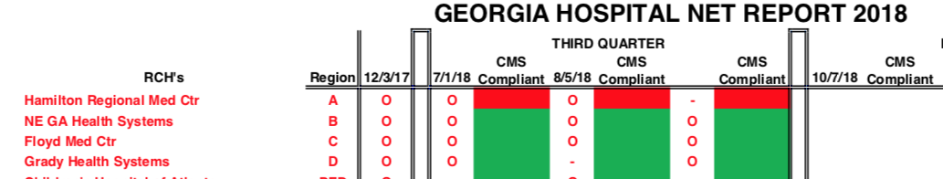
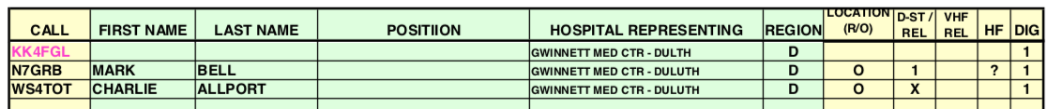
Monthly Hospital Net Exercise Reports
Facility Status
Operator Participation
Notes:
At the Georgia ARES state level monthly ARES hospital nets are documented
Participation by each health facility
Annotated to show operational status (GREEN for CMS external communications functionally compliant)
Participation has been preformed by onsite communications
Participation by each operator at the served location
Operating location (“O” onsite, “R” remote)
Methods of communication (D-Star radio net, VHF analog radio or relay, HF radio and digital messaging)

Slide 19
Key Elements to Success
Document radio external communications and training plans
Incorporate into facility emergency communications plan (CMS reqm’t)
Essential activation information in the event of an actual emergency
Consider defining facility-ARES relationship in Memorandum of Understanding
GA ARES Hospital Team Volunteers
Recruiting, staffing and training as an on-going process
Credentialed with GA ARES and the served facility
Integration into the facility’s volunteer staff and ICS program
Radio station equipment and maintenance
Facility administration supports the emergency communication function
Facility Engineering provides installation of coax runs, emergency power, etc.
Volunteers provide skills for radio installation and operation
Notes:
Documentation
Statement in Facility Emerg. Comm Plan for use of Amateur Radio for external comm meets a CMS requirement
Facility ICS Team must have and know method by which amateur radio function is formally activated (ARES does not self-deploy)
MOU formally defines the relationship between the ARES group and facility organization, includes many of the organizational elements necessary for success
The ARES Hospital Team members are emergency service volunteers!
When on-site are managed by the facility authority.
Credentials are required from the facility necessary for the volunteers to accomplish their assigned tasks during training and activations on a 24-hour basis (e.g., access radio room, facility EOC)
Volunteers should also have access to the cafeteria during all activations and it should be paid for by the facility or at least allowed to purchase at staff prices.
Support from Administration, Public Safety and Engineering
Antennas, coax cable and associated radio equipment carries an expense
Radio room / area should provide for physical security of equipment
If radio station is not located at facility EOC, provide some form of reliable two-way communication path to EOC operational under emergency power

Slide 20
Elements to Success – Communication Plan
Collaborative method for activating ARES resources
ARES resource role within facility ICS team
Consider use of HICS Emergency Radio Operator Job Sheet Aid
Essential information enabling message flow between:
Facility, county and regional partners (local government EMA, RCH)
Last-mile communication between radio station and the facility ICS center
Elements of last-mile communication to include
Location of facility EOC & radio room with points of contact
Methods of contact (e.g., phone, email, chat / WebEOC, hand courier)
Utilization of standard ICS forms and message handling practice
Notes:
ARES Hospital Team Operators are activated by the local facility:
Direct via GHA911 Everbridge or other means necessary as locally required
Request to the local county ARES Emergency Coordinator
In all cases the county EC shall be notified and if a large area disaster the county EMA EOC.
In the allocation of resources the county EC and EMA EOC are are partners in resource allocation.
When activated the ARES operator is under the direction of the facility incident command in the sole role of a volunteer communicator.
Identify local and regional partners, callsigns and methods of communication (e.g., analog, D-Star, HF, Winlink)
ICS 205 and 205A
Identify locations of radio room, facility EOC and the methods of communication between locations, identify methods that are functional under emergency power. Only as a last resort should operators leave their station to hand deliver / retrieve messages to / from a remote facility EOC.
All communication to follow ICS practices with utilization of standard ICS forms (e.g., ICS 213 message, ICS 309 comm log).

Slide 21
Elements to Success for ARES Members
Patience
Hospitals do not run at Internet time
Set a long term goal
Perseverance
Work with what you have
Be creative to obtain that which you need for your long term goal
e.g., grants, repurposed hospital equipment
Humility
Respect the leadership of the hospital administration and ICS Team
Stay focused on the mission

Slide 22
Questions?

Slide 23
Thank You
… for allowing Georgia ARES Hospital Team to assist your health facility in meeting your emergency communications needs within the CMS mandate!
We are happy to serve!

Slide 24
References
Emergency Preparedness Requirements for Medicare and Medicaid Participating Providers and Suppliers [includes 42 CFR 482.15(c)(3)]
https://www.federalregister.gov/d/2016-21404
[CMS] State Operations Manual Appendix Z- Emergency Preparedness for All Provider and Certified Supplier Types Interpretive Guidance
https://www.cms.gov/Regulations-and-Guidance/Guidance/Manuals/downloads/som107ap_z_emergprep.pdf
Georgia ARES Hospital Team https://gaares.org/heop.php
Georgia ARES Hospital Emergency Operations Plan
HICS Emergency Radio Operator Job Sheet Aid
http://hicscenter.org/SitePages/JASs-JobAids.aspx

